Slide 1
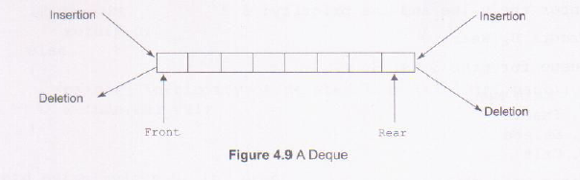
DEQUE
Deque (short form of double-ended queue) is a linear list in which elements can be inserted or deleted at either end but not in the middle.
That is, elements can be inserted/deleted to/ from the rear or the front end.
Figure 4.9 shows the representation of a deque.

Slide 2
DEQUE
#define MAX 30
typedef struct dequeue
{
int data[MAX];
int rear,front;
}dequeue;

Slide 3
DEQUE
void initialize(dequeue *p);
int empty(dequeue *p);
int full(dequeue *p);
void enqueueR(dequeue *p,int x);
void enqueueF(dequeue *p,int x);
int dequeueF(dequeue *p);
int dequeueR(dequeue *p);
void print(dequeue *p);

Slide 4
DEQUE
void initialize(dequeue *p);
int empty(dequeue *p);
int full(dequeue *p);
void enqueueR(dequeue *p,int x);
void enqueueF(dequeue *p,int x);
int dequeueF(dequeue *p);
int dequeueR(dequeue *p);
void print(dequeue *p);

Slide 5
DEQUE
void initialize(dequeue *P)
{
P->rear=-1;
P->front=-1;
}

Slide 6
DEQUE
void initialize(dequeue *p);
int empty(dequeue *p);
int full(dequeue *p);
void enqueueR(dequeue *p,int x);
void enqueueF(dequeue *p,int x);
int dequeueF(dequeue *p);
int dequeueR(dequeue *p);
void print(dequeue *p);

Slide 7
DEQUE
int empty(dequeue *P)
{
if(P->rear==-1)
return(1);
return(0);
}
int full(dequeue *P)
{
if((P->rear+1)%MAX==P->front)
return(1);
return(0);
}

Slide 8
DEQUE
void initialize(dequeue *p);
int empty(dequeue *p);
int full(dequeue *p);
void enqueueR(dequeue *p,int x);
void enqueueF(dequeue *p,int x);
int dequeueF(dequeue *p);
int dequeueR(dequeue *p);
void print(dequeue *p);

Slide 9
DEQUE
void enqueueR(dequeue *P, int x)
{
if(empty(P))
{
P->rear=0; P->front=0;
P->data[0]=x;
}
else
{
P->rear=(P->rear+1)%MAX;
P->data[P->rear]=x;
}
}

Slide 10
DEQUE
void initialize(dequeue *p);
int empty(dequeue *p);
int full(dequeue *p);
void enqueueR(dequeue *p,int x);
void enqueueF(dequeue *p,int x);
int dequeueF(dequeue *p);
int dequeueR(dequeue *p);
void print(dequeue *p);

Slide 11
DEQUE
void enqueueF(dequeue *P, int x)
{
if(empty(P))
{
P->rear=0; P->front=0;
P->data[0]=x;
}
else
{
P->front=(P->front-1+MAX)%MAX;
P->data[P->front]=x;
}
}

Slide 12
DEQUE
void initialize(dequeue *p);
int empty(dequeue *p);
int full(dequeue *p);
void enqueueR(dequeue *p,int x);
void enqueueF(dequeue *p,int x);
int dequeueF(dequeue *p);
int dequeueR(dequeue *p);
void print(dequeue *p);

Slide 13
DEQUE
int dequeueF(dequeue *P)
{
int x;
x=P->data[P->front];
if(P->rear==P->front) /*delete the last element */
initialize(P);
else
P->front=(P->front+1)%MAX;
return(x);
}

Slide 14
DEQUE
void initialize(dequeue *p);
int empty(dequeue *p);
int full(dequeue *p);
void enqueueR(dequeue *p,int x);
void enqueueF(dequeue *p,int x);
int dequeueF(dequeue *p);
int dequeueR(dequeue *p);
void print(dequeue *p);

Slide 15
DEQUE
int dequeueR(dequeue *P)
{
int x;
x=P->data[P->rear];
if(P->rear==P->front)
initialize(P);
else
P->rear=(P->rear-1+MAX)%MAX;
return(x);
}

Slide 16
DEQUE
void initialize(dequeue *p);
int empty(dequeue *p);
int full(dequeue *p);
void enqueueR(dequeue *p,int x);
void enqueueF(dequeue *p,int x);
int dequeueF(dequeue *p);
int dequeueR(dequeue *p);
void print(dequeue *p);

Slide 17
DEQUE
void print(dequeue *P)
{
if(empty(P))
{
printf("\nQueue is empty!!"); exit(0);
}
int i ; i=P->front;
while(i!=P->rear)
{
printf("\n%d",P->data[i]); i=(i+1)%MAX;
}
printf("\n%d\n",P->data[P->rear]);
}

Slide 18
REFER
DS Lab Manual for complete program

Slide 19
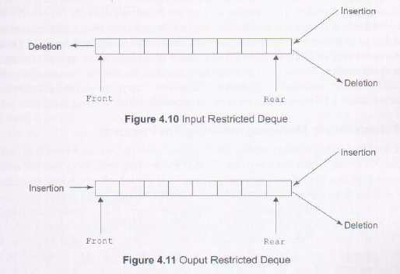
VARIATIONS OF DEQUE
There are two variations of a deque that are as follows:
(1)Input restricted deque: It allows insertion of elements at one end only but deletion can be done at both ends.
(2)Output restricted deque: It allows deletion of elements at one end only but insertion can be done at both ends.
The implementation of both these queues is similar to the implementation of deque. The only difference is that in input restricted queue, function for insertion in the beginning is not needed whereas in output-restricted queue, function for deletion in the beginning is not needed.

